Slide 1
IAS Machine

Slide 2
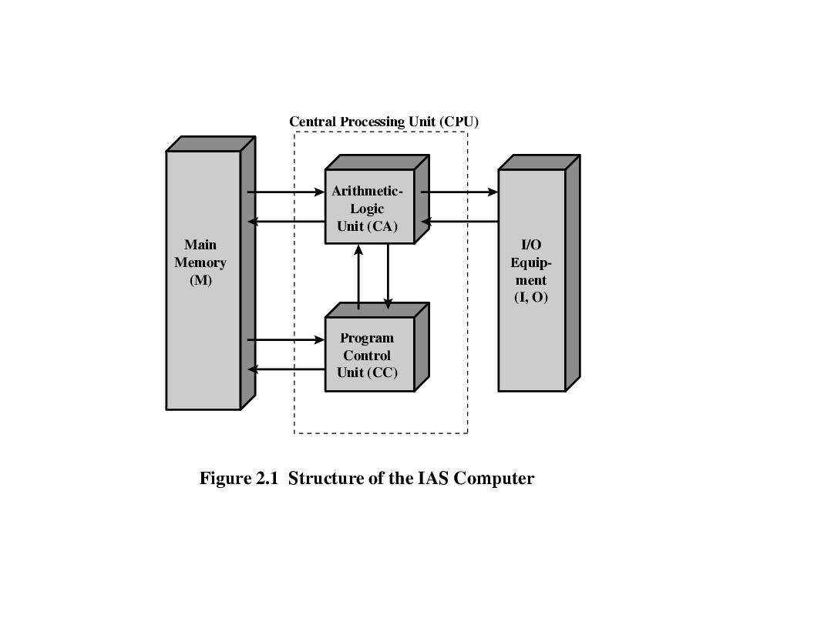
Organization of the von Neumann machine
IAS – a prototype developed by John Von Neumann in 1946 at Princeton
University. (Institute for Advanced Study)
Structure of Von Neumann machine(IAS Computer)
Notes:
IAS: Institute for Advanced Studies.

Slide 3
IAS – memory format
1000 x 40 bit words ( 1000 storage locations of 40 binary bits each)
Binary number( both data and instructions are stored here)
Number Format:
Each number is represented by a sign bit and a 39 bit value.
Instruction Format:
A word may contain 20 bit instruction with each instruction consisting of an 8 bit operation code (opcode) specifying the operation to be performed and a 12 bit address designating one of the words in memory (0 to 999)

Slide 4
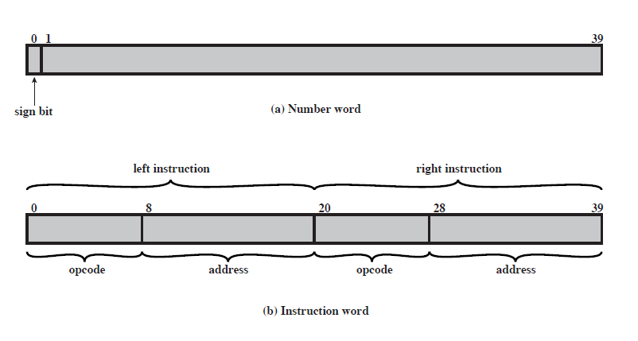
IAS – Contd..
Memory Formats
1000 x 40 bit words ( 1000 storage locations of 40 binary bits each)
Binary number( both data and instructions are stored here)
Number Format
Each number is represented by a sign bit and a 39 bit value.
Instruction Format
- 20-bit instruction, 8-bit operation code (opcode)
-12-bit address

Slide 5
IAS – Contd..
IAS – Total 21 Instructions
Data Transfer
Unconditional Branch Instruction
Conditional Branch Instruction
Arithmetic
Address Modify Instruction

Slide 6
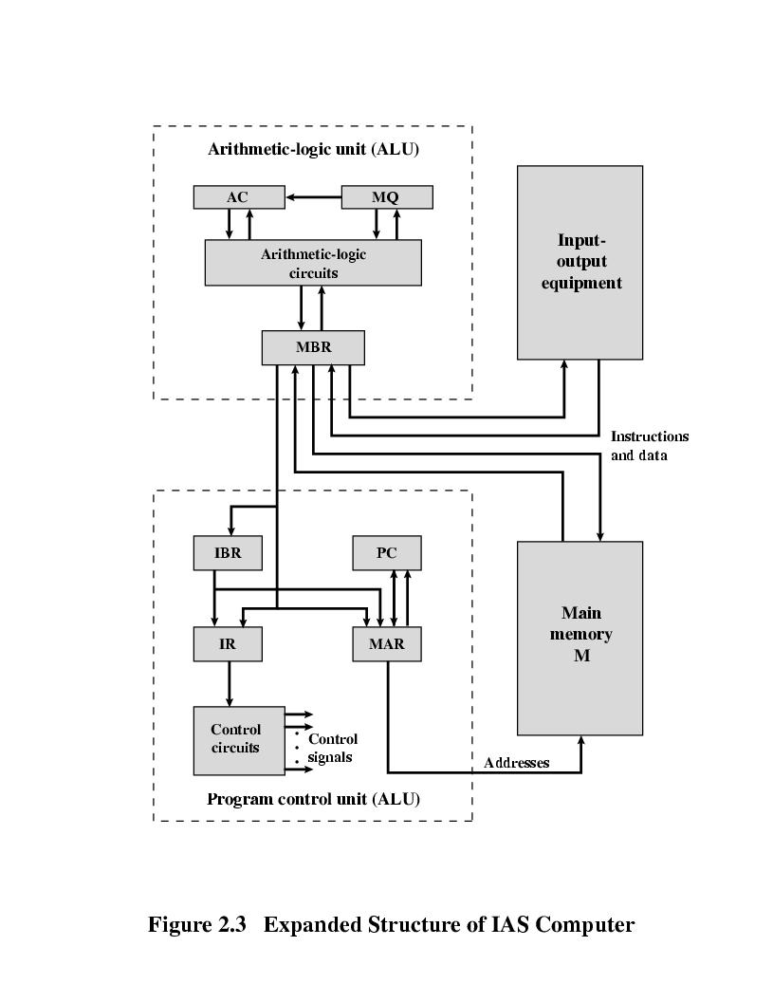
Expanded Structure of IAS

Slide 7
Expanded structure of IAS computer
Set of registers (storage in CPU)
Memory Buffer Register (MBR)
Contains a word to be stored in memory or sent to the I/O unit, or it is used to receive a word from memory or from the I/O unit.
Memory Address Register (MAR)
Specifies the address in memory of the word to be written from or read into the MBR.
Instruction Register (IR)
Contains the 8 bit opcode instruction being executed.
Instruction Buffer Register (IBR)
Employed to hold temporarily the right hand instruction from a word in memory
Program Counter (PC)
Contains the address of the next instruction pair to be fetched from memory
Accumulator (AC) & Multiplier Quotient (MQ)
Employed to hold temporarily the right hand instruction from a word in memory. For eg. The result of multiplying two 40 bit numbers is an 80 bit number, the most significant 40 bits are stored in the AC and the least significant in the MQ.

Slide 8
IAS Operation - Flowchart
AC
MQ
Input/output
Equipments
MAR←PC
No
Is next instruction in IBR?
MBR←M[MAR]
Arithmetic & Logic Circuits
IBR←MBR<20..39>
IR←MBR<0..7>
MAR←MBR<8..19>
yes
MBR
MBR←M[MAR]
AC←MBR
IR←IBR<0..7>
MAR←IBR<8..19>
IBR
PC
Main Memory
PC←PC+1
PC←MAR
MBR←M[MAR]
IR
MAR
AC← MBR
Control
Circuits

Slide 9

AC = 7
AC = 3
MEMORY
1. LOAD M(X) 500, ADD M(X) 501
2. STOR M(X) 500, (Other Ins)
.....
3
4
AC
MQ
500
MBR = 4
LOAD M(X)
MBR
MBR = 3
500
ADD M(X) 501
(Other Ins)
STOR M(X)
PC
1
2
MAR
1
500
501
2
500
MBR
LOAD M(X) 500, ADD M(X) 501
3
4
STOR M(X) 500, (Other Ins)
IR
LOAD M(X)
ADD M(X)
STOR M(X)
IBR
ADD M(X) 501
(Other Ins)
AC
3
501
PC = 2
7
IBR
PC = 1
Add M(X)
Mar ← PC
MAR ←PC
3
LOAD M(X) 500, ADD M(X) 501
4
IR
MAR = 2
STOR M(X) 500, (Other Ins)
MAR = 501
MAR = 1
MAR = 500
MAR =500
add = 501
add = 1
add = 500
add = 2

Slide 10
Register transfer operation for addition operation
1. LOAD M(X) 500, ADD M(X) 501
Register transfer operations: (PC = 1)
MAR ← PC
MBR ← M[MAR]
IBR ← MBR[20:39]
IR ← MBR[0:7]
MAR ← MBR[8:19]
MBR ← M[MAR]
AC ← MBR
IR ← IBR[0:7]
MAR ← IBR[8:19]
MBR ← M[MAR]
AC ← AC + MBR

Slide 11
Fetch / Execute Cycle

Slide 12
AC = 7
AC = 3
MEMORY
1. LOAD M(X) 500, ADD M(X) 501
2. STOR M(X) 500, (Other Ins)
.....
3
4
AC
MQ
500
MBR = 4
LOAD M(X)
MBR
MBR = 3
500
ADD M(X) 501
(Other Ins)
STOR M(X)
PC
1
2
MAR
1
500
501
2
500
MBR
LOAD M(X) 500, ADD M(X) 501
3
4
STOR M(X) 500, (Other Ins)
IR
LOAD M(X)
ADD M(X)
STOR M(X)
IBR
ADD M(X) 501
(Other Ins)
AC
3
501
PC = 2
7
IBR
PC = 1
Add M(X)
Mar ← PC
MAR ←PC
3
LOAD M(X) 500, ADD M(X) 501
4
IR
MAR = 2
STOR M(X) 500, (Other Ins)
MAR = 501
MAR = 1
MAR = 500
MAR =500
add = 501
add = 1
add = 500
add = 2

Slide 13
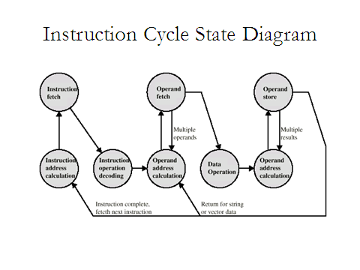
Notes:
Note: This is an instruction cycle state diagram without interrupts

Slide 14
Instruction set: Collection of instructions that the CPU can execute
What an Instruction set should specify?
Which Operation to perform (Opcode)
Where to find the operand or operands (CPU registers, main memory or I/O port)
Where to put the result, if there is result
Where to find the next instruction

Slide 15
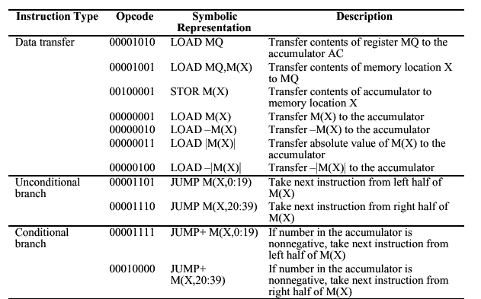
IAS Instruction set

Slide 16
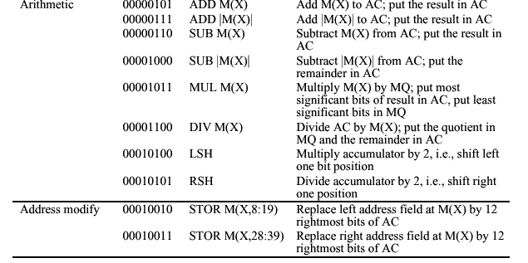
IAS Instruction set Contd..

Slide 17
References
Reference Book
W. Stallings, Computer organization and architecture, Prentice-Hall,2000
J. P. Hayes, Computer system architecture, McGraw Hill,2000
Vincent .P. Heuring, Harry F. Jordan “ Computer System design and Architecture” Pearson, 2nd Edition, 2003

